Slide 1
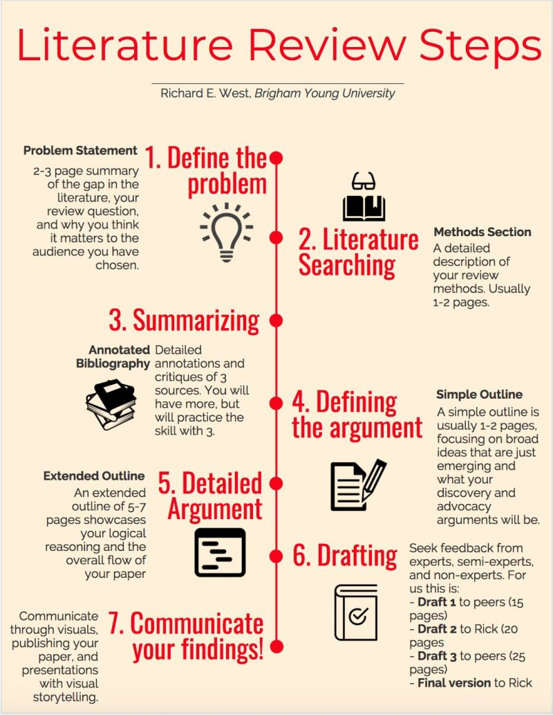

Slide 2
Defining the Scope and Objectives of a Literature Review
1. Identify the Research Question: Start by clearly defining your research question or hypothesis. This will guide the focus of your literature review.
2. Set Objectives: Determine what you aim to achieve with your literature review. Objectives may include identifying gaps in the literature, understanding theoretical frameworks, or summarizing current findings.
3. Define the Scope: Establish the boundaries of your review. Consider the time frame, geographical location, and specific aspects of the topic you will cover.

Slide 3
Effective Search Strategies for Finding Relevant Literature
1. Develop a Search Plan: Outline your search strategy, including keywords, databases, and search engines you will use. Common databases include PubMed, Google Scholar, JSTOR, and Scopus.
2. Use Keywords and Boolean Operators: Identify relevant keywords and use Boolean operators (AND, OR, NOT) to refine your search. For example, "climate change AND agriculture" will yield results that include both terms.
3. Explore Multiple Sources: Search across various databases and sources, including academic journals, books, conference papers, and dissertations. Don't rely on a single source.
4. Track Your Searches: Keep a record of your search terms, databases used, and the number of results. This helps ensure a systematic approach and allows you to replicate your search if needed.

Slide 4
Evaluating and Selecting
High-Quality Sources
1. Assess Relevance: Review the abstracts and conclusions of articles to determine their relevance to your research question. Focus on sources that directly address your topic.
2. Check Credibility: Evaluate the credibility of sources by considering the author's qualifications, the publication's reputation, and the peer-review process.
3. Examine Methodology: Assess the research methods used in the studies. High-quality sources should employ rigorous and appropriate methodologies.
4. Look for Citations: Consider how often a source has been cited by other researchers. Highly cited sources are often influential and recognized in the field.

Slide 5
Organizing and Synthesizing the Literature
Create an Outline: Organize your literature review by creating an outline that groups sources by themes, methodologies, or chronological order.
2. Summarize Key Findings: Write summaries of each source, highlighting key findings, methodologies, and contributions to the field.
3. Identify Patterns and Gaps: Look for patterns, trends, and gaps in the literature. Identify areas where further research is needed.
4. Synthesize Information: Integrate the findings from multiple sources to provide a comprehensive overview of the topic. Discuss how different studies relate to each other and to your research question.

Slide 6
Writing and Presenting the Literature Review
1. Introduction: Begin with an introduction that outlines the purpose and scope of your literature review. Provide context for your research question.
2. Body: Organize the body of your review into sections based on themes, methodologies, or chronological order. Use headings and subheadings to guide the reader.
3. Critical Analysis: Critically analyze the sources, discussing their strengths, weaknesses, and contributions to the field. Highlight any conflicting findings and provide your interpretation.
4. Conclusion: Summarize the main findings of your literature review and discuss their implications for your research question. Identify any gaps and suggest areas for future research.
5. References: Include a comprehensive list of all sources cited in your literature review, formatted according to the appropriate citation style (e.g., APA, MLA, Chicago).

Slide 7
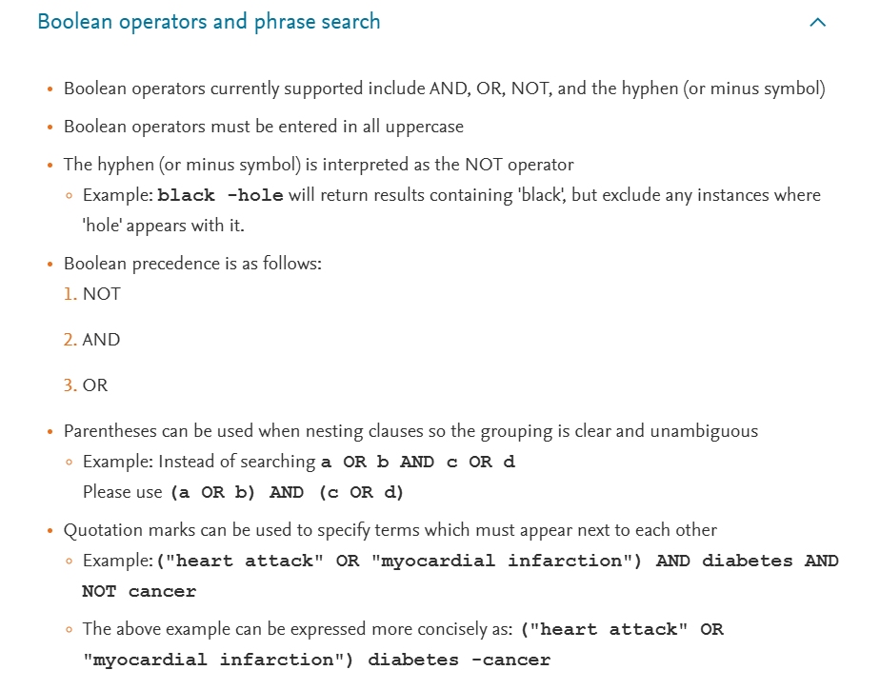

Slide 8
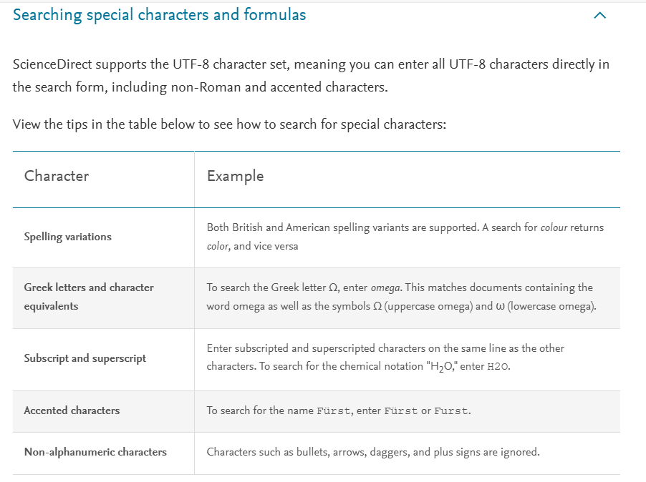

Slide 9
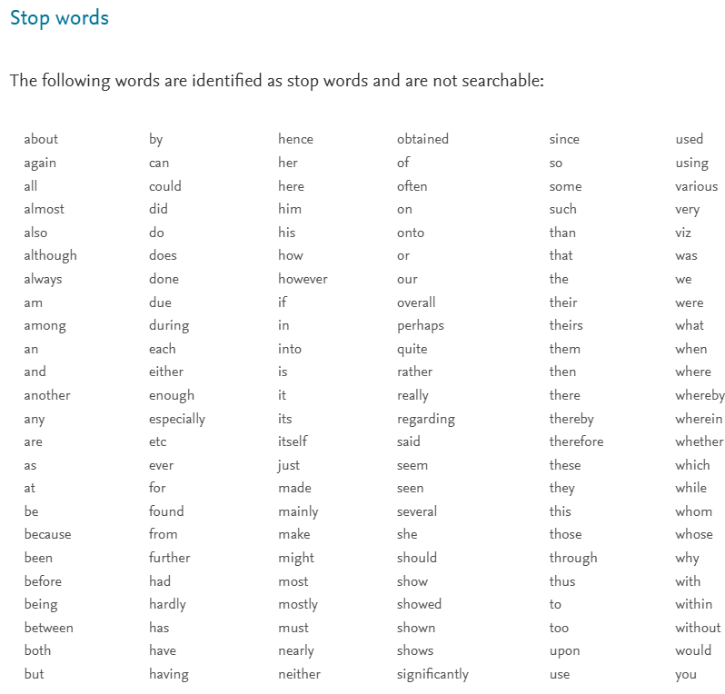

Slide 11
